Slide 1
Pandas Data Frame

Slide 2
Definition – Pandas Data Frame
Multi-Dimensional Data Structure
Consists of rows and columns
SQL
Excel tables
Very useful in data analytics
Data not required to be in fixed type
Advantage over Numpy
Data can be categorical and continuous
Series
Data Frame
1
2
3
4
1 | 2 | 3
4 | 5 | 6
7 | 8 | 9
10 | 11 | 12

Slide 3
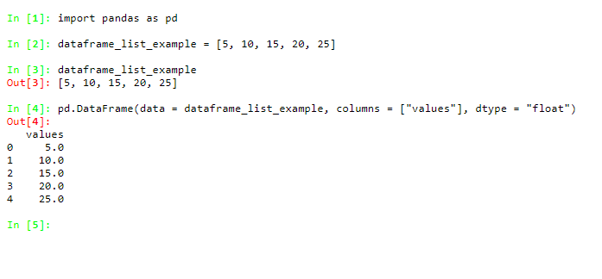
Creating Pandas Data Frame with a LIST

Slide 4
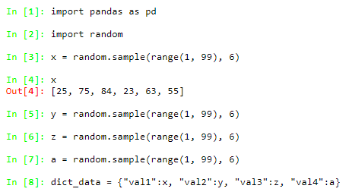
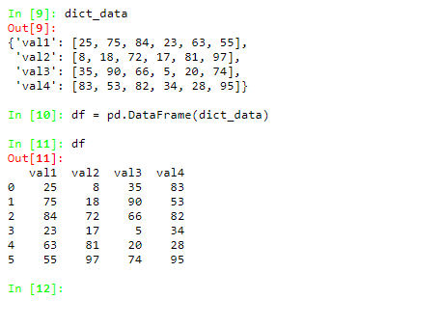
Creating Pandas Data Frame with a DICTIONARY

Slide 5
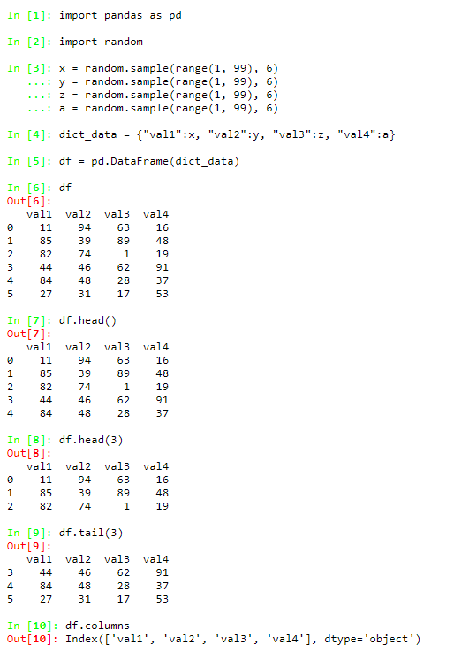
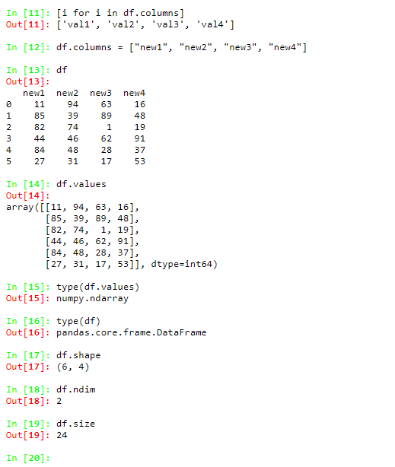
Properties of Pandas Data Frame

